Slide 1
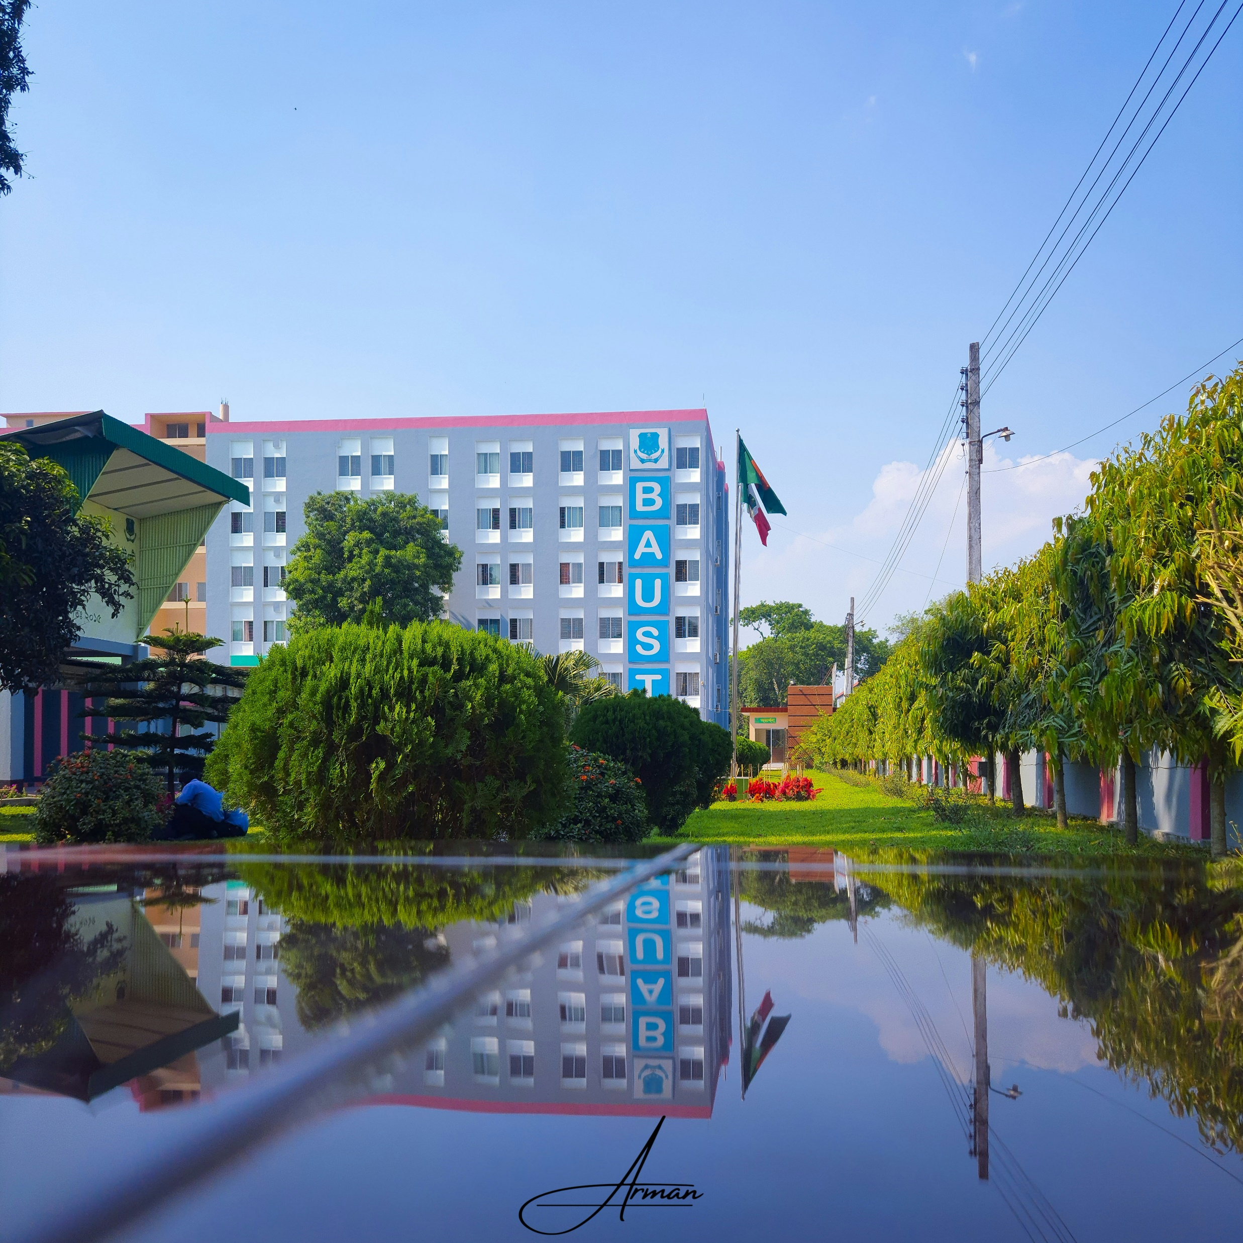

Group Information
Bangladesh Army University
of Science and Technology
(BAUST)
Department of
Computer Science and Engineering
(CSE)
High School Management System
Course code : CSE 2206
Course title : Database Management Systems Sessional
Course teacher : Hasan Muhammad Kafi, Assistant Professor
Group members

Slide 2




Group Information
Bangladesh Army University
of Science and Technology
(BAUST)
Ifti Haque
210201020
Md. Nihad Hossain
210201023
Department of
Computer Science and Engineering
(CSE)
Project name:
High School Management System
Course code : CSE 2206
Course title : Database Management Systems Sessional
Course teacher : Hasan Muhammad Kafi, Assistant Professor
Group members
Md. Nur A Alam
210201044
Rakib Hasan Fahim
210201045

Slide 3










Table of Contents
Introduction
Methodology
Problem Definition
Tools and Technology
Objectives
Conclusion
Related Available Projects
References
Project title: High School Management System

Slide 4










Introduction
It is a well-featured user interactable web-based application.
It will evaluate and grow students skills according to their performance.
Improve communication between authorities and students.
Project title: High School Management System

Slide 5



Problem Definition
Struggle with manual and time-consuming process.
Data Management Complexity
Challenging for effective communication
Lack of Real-Time Updates
Security and Privacy Risks
Difficulty in Performance Analysis
Project title: High School Management System

Slide 6

Objectives
To simplify administrative tasks
To enhance communication
To evaluate and grow students skills
Project title: High School Management System

Slide 7

Related available projects
Related projects | Features | Limitations
Fekara | Comprehensive, Internal messaging system, User management. | Limited storage, Paid software
Fedena | Customizable, Online learning module, Affordable, Easy to use. | Hassle of registration, Paid software
Ascend SMS | Discipline Reporting, Relation between parents and educator, SMS Student Info Management | Limits the number of schools, only free to Catholic
SchoolTool | Attendance Tracking, Free software, Parent and Teacher Portals | Data Security Concerns, User Interface, Feature Set, Scalability.
Classe365 | instant SMS Notifications, Finance and Billing, Gradebook and Assessment | User Adoption, Integration Options, Internet Dependency, Learning Curve
Project title: High School Management System

Slide 8

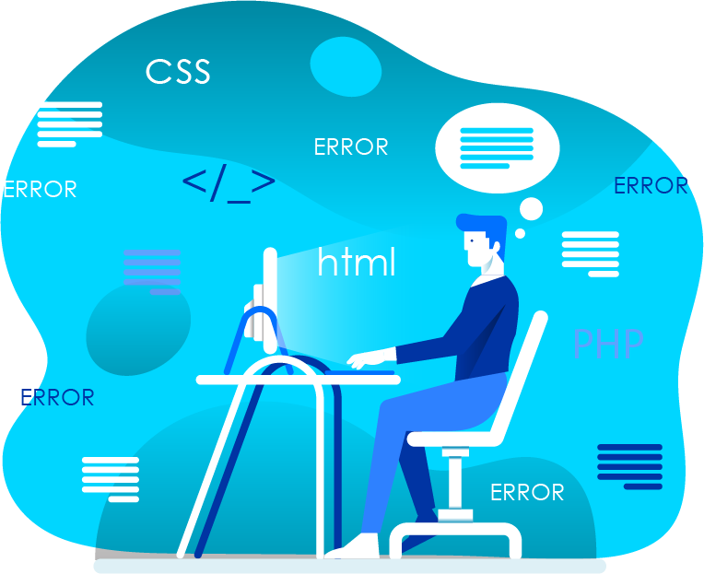
Methodology
Methodology
Requirement Analysis
And Specification
Design Phase
Waterfall
Model
Implementation
And Unit Testing
Integration And
System Testing
Operation And
Maintenance Fees
Project title: High School Management System

Slide 9

Tools and technology
Programming Languages:
PHP
HTML
CSS
JavaScript
Database Management System:
MySQL
Frameworks:
Laravel
Version Control:
Git
Project title: High School Management System

Slide 10

Conclusion
Automation and efficiency
Enhanced communication
Real-time data access
Data accuracy and consistency
Iterative development process
Project title: High School Management System

Slide 11

References
HTML CSS Documentation: https://www.w3schools.com/html/html_css.asp
PHP Documentation: https://www.php.net/docs.php
MySQL Documentation: https://dev.mysql.com/doc/
Laravel Documentation: https://laravel.com/docs
Project title: High School Management System

Slide 12

Project title: High School Management System

